Slide 1
The Scrum-Agile Approach
Presented by:
Jacob McPherson

Slide 2
The roles of your Scrum-agile team
Product Owner – Gives the team direction and ensures value is being delivered to the customer. "who serves as an interface between the team and other involved parties"
Scrum Master – Ensures the team follows the rules of scrum and removes any impediments to the team. "The Scrum Master is what is known in agile as a servant leader. He/she has the responsibility to facilitate the team."
Testers – Create, maintain, and adjust test cases to ensure the product is working to the requirements given. Testers work along side developers to make sure all possibilities are covered.
Developers – Create and maintain the product. Developers and testers determine the workload they're going to complete during the beginning of each sprint. Developers are always in contact with each member of the team.

Slide 3
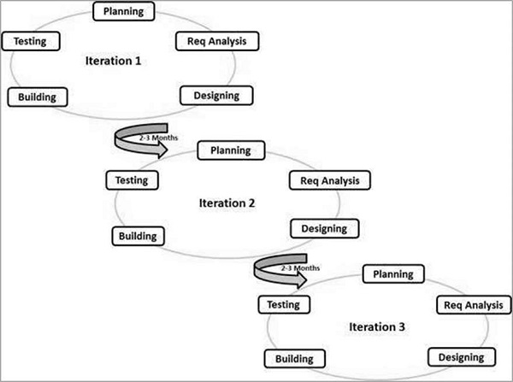
Phases of the Scrum-Agile SDLC
Planning – This phase is where the team goes over the overall requirements for the project including, overall goal, functionality, work to be undertaken, and partner planning when needed.
Req. Analysis – This is when the team delves into the individual requirements of each user story (work task) that is being undertaken in that sprint period (iteration).
Designing – This is when the team begins making the project pieces. Here teams are developing and testing the code or product tasks chosen at the beginning of the sprint period (iteration).
Building – At this point the team is integrating the different pieces together to make sure they work properly together and don't create unknown issues when integrated.
Testing – This is the final testing phase. Testing should have been done in all developmental stage, but this is the point where final stress tests are made on the fully integrated product before it's brought up for sprint review.
Iterations – At the beginning of each iteration after the first, the completed product from the iteration before is reviewed and the remaining work is then prioritized and selected for the current iteration. At the end of each iteration the work completed during the current iteration is brought up for review and final testing for the customer. Here any changes or questions can be made by the customer if needed.

Slide 4
What would have been different?
The agile approach allowed for easy integration of changes the customer wanted to make before the product was completed and ready for send off.
If this project had been done using a waterfall approach, any changes couldn't have been made or mentioned until the end of the project when the customer is being handed the finished product.
During our current project we received an email from our product owner telling us that the display should be changed from a scroll list to a slideshow presentation. Had we decided to handle this with a waterfall approach, we would have had to nearly start the project over to replan for the new display choice. The short sprint lengths in agile allow for constant review from the customer before final product turn over.

Slide 5
What to consider when choosing
When it comes to considering what approach to go with at the beginning of a project I've found it comes down to three things.
The first is the level of uncertainty in a project. In our SNHU project we were very uncertain what the customer wanted in the destination display outside of destinations.
The second being the size of the project. Agile works great for small to medium projects where there shouldn't be a massive amount of complexity. The more diverse and complex the project becomes, it's better to have more of a structured plan going in.
Finally the amount of team cooperation you expect to go on. For agile theres a large level of communication and team colaboration. The level of uncertainty in some agile project can make it hard on a team that can't physically be there or have trouble working together cohesivly. A more structured waterfall approach would allow individuals to go in and do the work with less physical meetings.

Slide 6
Citations
agile42. (2020, August 26). Scrum roles. https://www.agile42.com/en/agile-community/agile-info-center/scrum/scrum-roles/
Cobb, C. G. (2015). The Project Manager’s Guide to Mastering Agile: Principles and Practices for an Adaptive Approach (1st ed.). Wiley.
SDLC - Agile Model. (n.d.). Tutorials Point. Retrieved August 15, 2021, from https://www.tutorialspoint.com/sdlc/sdlc_agile_model.htm

